Slide 1
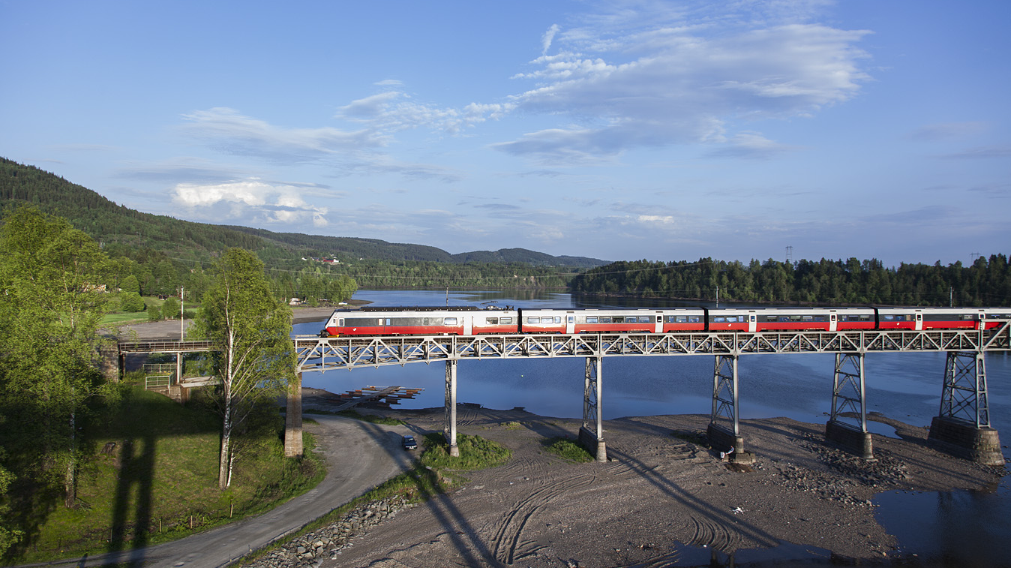
What is TEN-T and how does Norway participate in TEN-T?
What are EUs main priorities and ambitions for the transport sector?
Webinar: “CROSS BORDER RAILWAY SOLUTIONS OF THE FUTURE”
Carsten Horn-Hanssen, Counsellor for Transport, 23 October 2020
Olav Heggø - SD

Slide 2
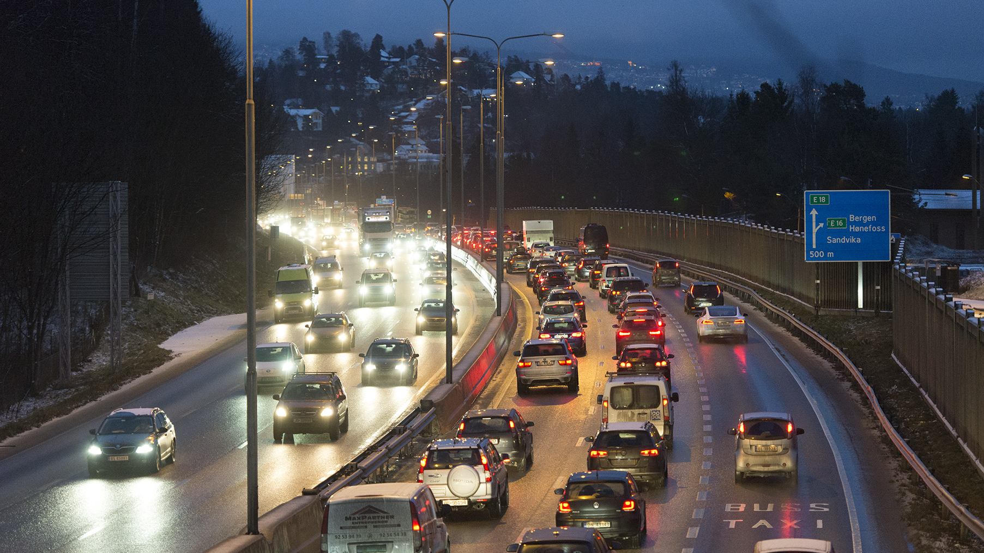
Increase in demand
Emissions
Accidents
Olav Heggø - SD

Slide 3
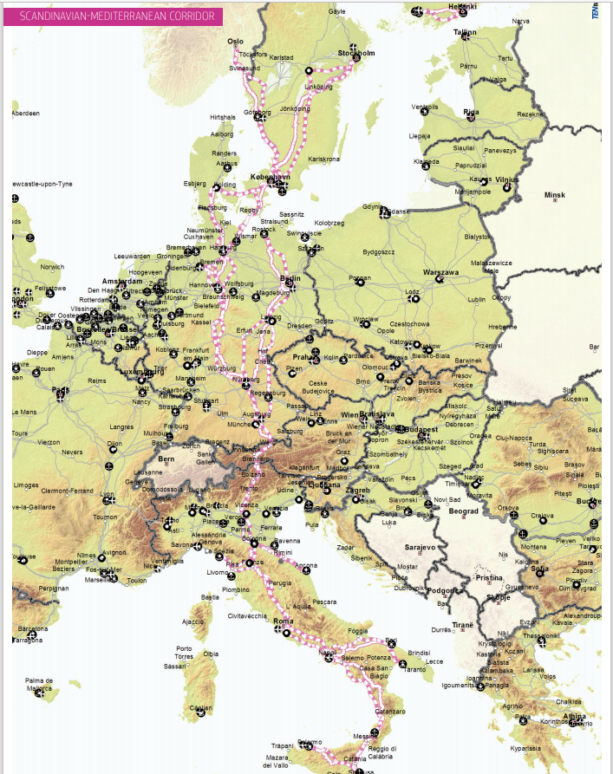
Trans-European Network - Transport
Core Network (2030)
The Comprehensive Network (2050)
“Scandinavian – Mediterranean” Corridor
TEN-T & CEF Regulation
“Downloads” DG Move website

Slide 4
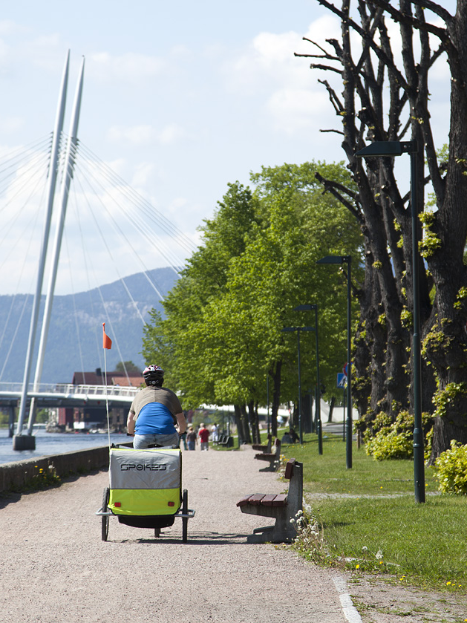
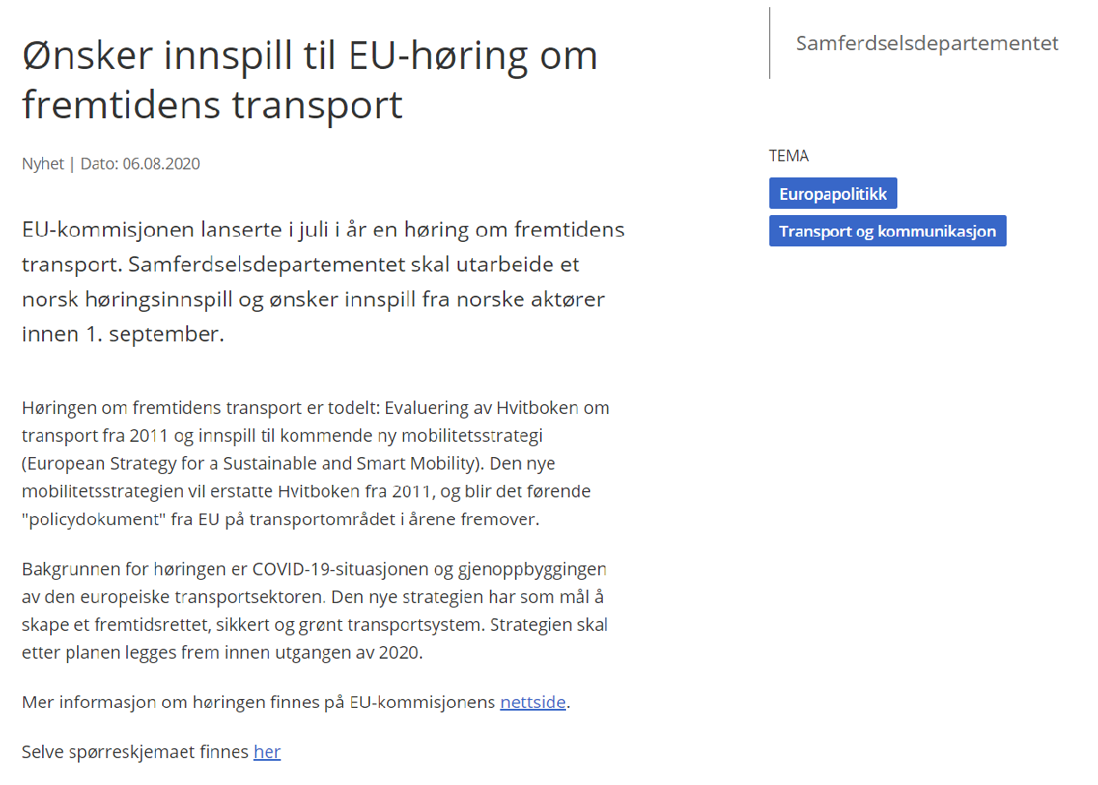
Norwegian input to new transport strategy on “Smart and sustainable transport”
Olav Heggø - SD

Slide 5
Carsten Horn-Hanssen
cahh@mfa.no
Samferdselsråd
Den norske EU-delegasjonen

