Slide 1
Welcome to Hedmark and Hamar

Slide 2
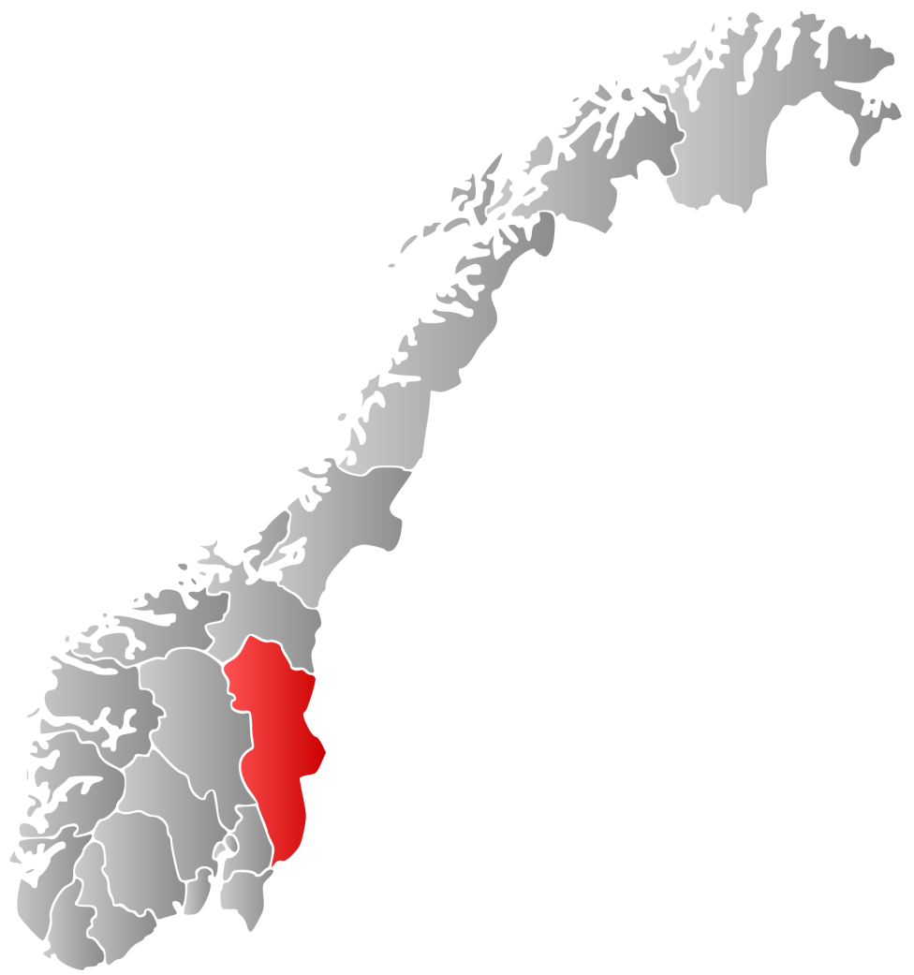
Hedmark
ONE OF NORWAY’S 19 COUNTIES
AREA: 27.388 km², 3rd biggest in Norway
22 MUNICIPALITIES
POPULATION: 195 153
DENSITY: 7 persons pr. km²
4,2% OF NORWAY’S POP
THE REGIONAL CENTRE: Hamar
THE DISTANCE FROM HAMAR TO OSLO IS 120 KM.
THE INTERNATIONAL AIRPORT GARDEMOEN ONE HOUR BY TRAIN.

Slide 3
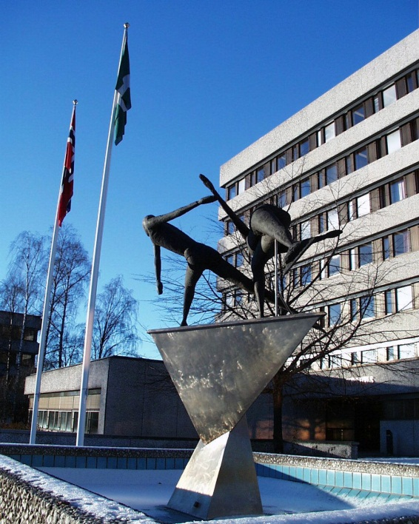
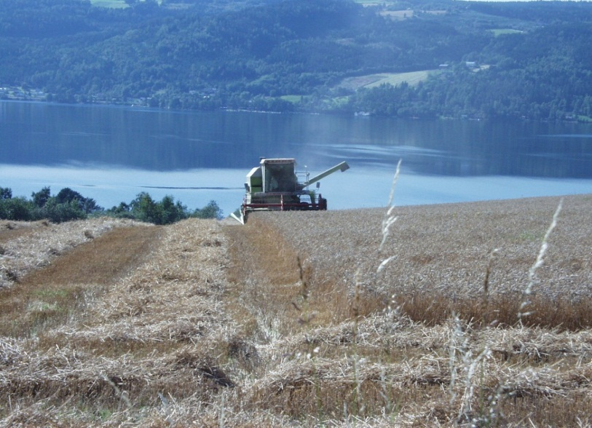
Worklife and employment
Public sector: 34,5%
Forestry and farming: 7,5%
Industry: 14%
Services (transport, retail, banking and insurance, building and construction, other private services): 44%

Slide 4
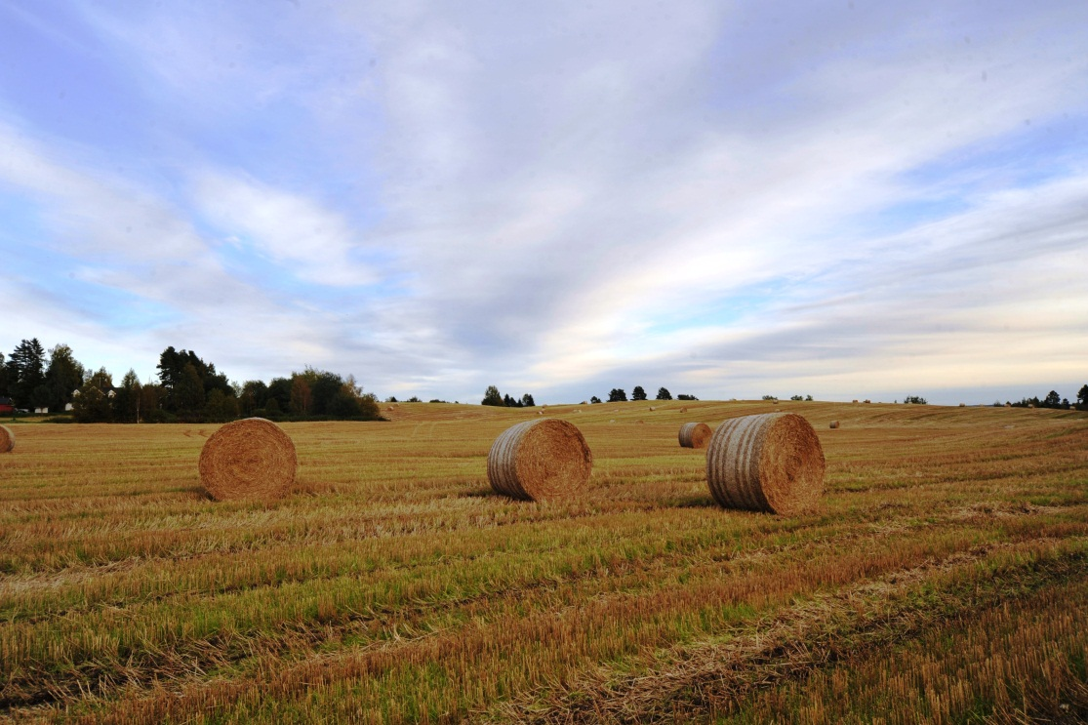
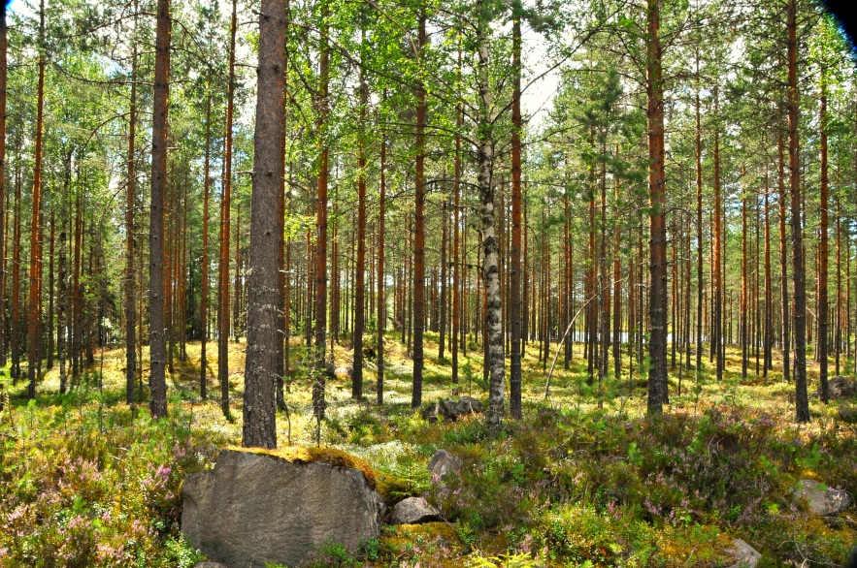
FORESTRY and FARMING - The forestry county
Hedmark is one of the counties with the largest productive forestry area in Norway and largest area of productive farming
49% of Hedmark’s total area is forest
Norway’s biggest producer of wheat, potatoes and poultry
Research and development related to farming and forestry (Bioeconomy)
New ways of farming (Small scale local food production, Eco-farms, Rural turism)

Slide 5
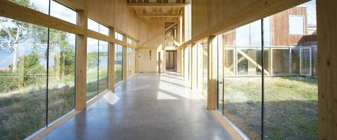
INDUSTRY
Forest industry
The Moelven Group – wood construction
- Industrial packaging, energy systems, industry related to car industry

Slide 6
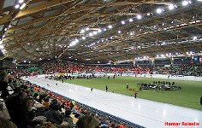
TOURISM
- Norway’s biggest ski destinations
Hedmark for summer and winter activities, nature and culturebased tourism
International sports arrangements (Speed-skating)
Youth Olympic games 2016

Slide 7
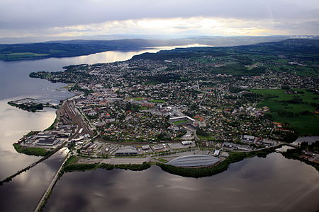
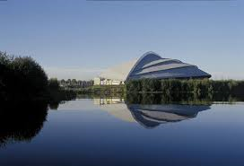
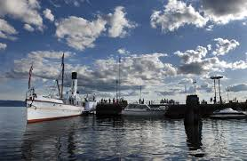
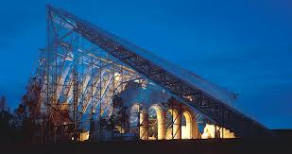
Hamar – The regional centre in Hedmark

Slide 8
Thank you for your attention!

