Slide 1
Focus area FILM
Common Commission meeting
Schleswig-Holstein –
Eastern Norway County Network
Terje Kongsrud – 7th May 2015

Slide 2
Focus area FILM
Presentation of the work in Hedmark/Oppland and the joint cooperation with Schleswig-Holstein
– new ideas and possibilities

Slide 3
Institutions
Film3
Østnorsk Filmsenter
Hamarama Filmfestival
Movies on War Filmfestival
Norwegian Student Film Festival
Amandus Film Festival for Children and Youth
Fabelaktiv
Hamar Game Collective
NRK
Filmbanken

Slide 4
Higher education
The Norwegian Film School
Documentary Film Production
Multi-camera Production
Media Production
Game Programming
Animation and digital arts
Gaming technology and simulation
Digital fiction
Visual culture
Resarch film and tv

Slide 5
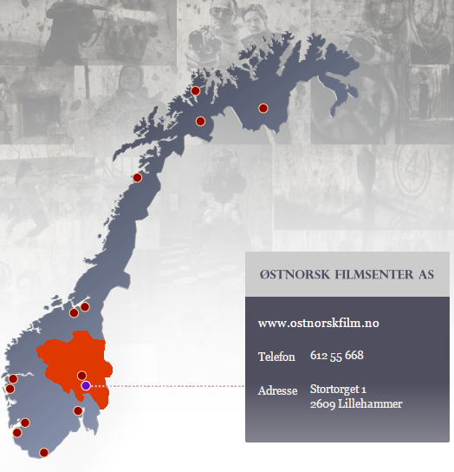

Slide 6
Østnorsk Filmsenter AS (“East Norwegian Film Center”)
funding short and documentary films
offering training courses and workshops
create meeting arenas and network among film workers
support film related activities for children and youth

Slide 7
Film3 AS
Film3 = film, funding and facilitation
Funding for film and television productions in Hedmark and Oppland

Slide 8
Funding

Slide 9
Ongoing German-Norwegian cooperation
Norddeutscher Rundfunk – NDR (Hamburg)
Nord Media (Bremen) + filmfestival Oldenburg
Cooperation for producers
Nordic Filmdays in Lübeck
Landesverband Jugend und Film (Schleswig-Holstein)
Internationale Bildungsstätte Jugendhof Scheersberg
Gebrueder Beetz Filmproduktion (Hamburg and Berlin)

Slide 10
ISUNGUR – Save Your Viking Village
An interactive web-based game about the legendary Vikings - Learning by Playing!
By Gebrueder beetz filmproduktion and SIRUP, in co-production with Fabelaktiv (Norway)

Slide 11
Viking Women
a two-part documentary and cross-media format by Gebrueder Beetz Filmproduktion
for NDR/arte

Slide 12
Trio – Odins Gold
Coproduction NDR and NRK
Developed in our region
Recorded in Skjåk and Hamburg
Sold to several countries
Kinder-TV-Preis «Emil»

Slide 13
And the Emmy goes to… Energy Survival

Slide 14
Norwegian-German Film Workshop
Landesverband Jugend und film, Schleswig-Holstein
Internationale Bildungsstätte Jugendhof Scheersberg
Oppland Youth Film Centre
Established 2013

Slide 15
Proposal for further actions
Continue young talent exchange
Young Nordic Film Link?
Film commission
Further cooperation production
Joint projects financed through EU-programmes?

